Slide 1
Dell Technologies HPC Community Online
Jeff Kirk
Senior Distinguished Engineer, ISG CTIO
28 June 2023

Slide 2
What IS the Dell Technologies HPC Community?
A community of practice that shares / exchanges information...
HPC Analysts, Media
Potential Partners
Dell
Partners
HPC Community
Customers
Potential Customers
Public w/ HPC interest
to advance and accelerate HPC solutions development and impact!
Notes:
Click 1…
A community of practice—a way to share / exchange information…
that brings together three primary stakeholder groups…
Click 2, 3, 4, 5…
Dell Technologies: engineers, technologists, product managers, sales, execs, etc.
HPC technology partner ecosystem: companies who partner with Dell (or may)
HPC customers: users, developers, IT admins, execs, etc. who buy / use Dell HPC solutions (or may)
and other HPC professionals—analysts, media, etc.--that want to learn and share!
Click 6…
The culmination of which is…. to advance and accelerate HPC solutions development and impact, through events and communications that
Educate / inform about opportunities, adoption, usage of HPC (democratize)
promote better development, management & usage of HPC (optimize)
share and discusses ideas for new, more capable HPC solutions (advance)

Slide 3
Dell HPC Community News
HPC Community Advisory Board
Still seeking a couple more interested thought leaders to join our Board
If Interested, email: info@dellhpc.org
Exciting Fall Schedule in Planning
Notes:
Our Events Include:
Online weekly events: presentations, conversations, town halls & community chats, breakouts, etc.—whatever is appropriate to achieve the objectives above!
In-person / hybrid meetings at ISC, at SC, and in Austin (spring 2024)

Slide 4
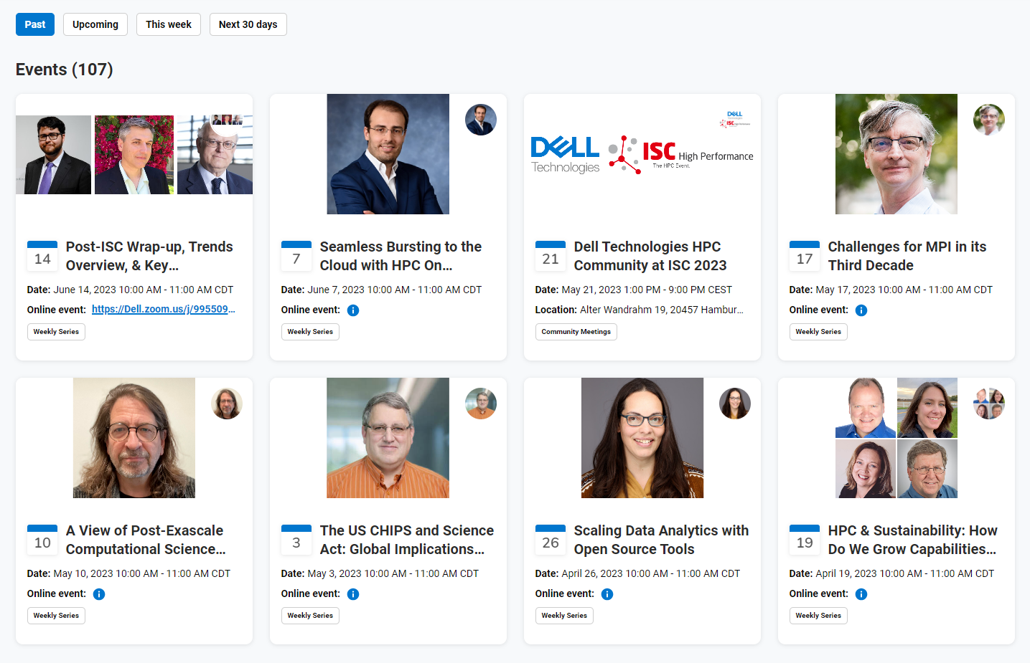
Weekly Event Reminders
All Weekly Online Events are Recorded and Posted
Click on Events menu, then the “Past” button
Weekly event recordings posted by next day
Slides are also posted, for most presentation-format events
Register in Advance for Our Weekly Events
https://dellhpc.org/events

Slide 5
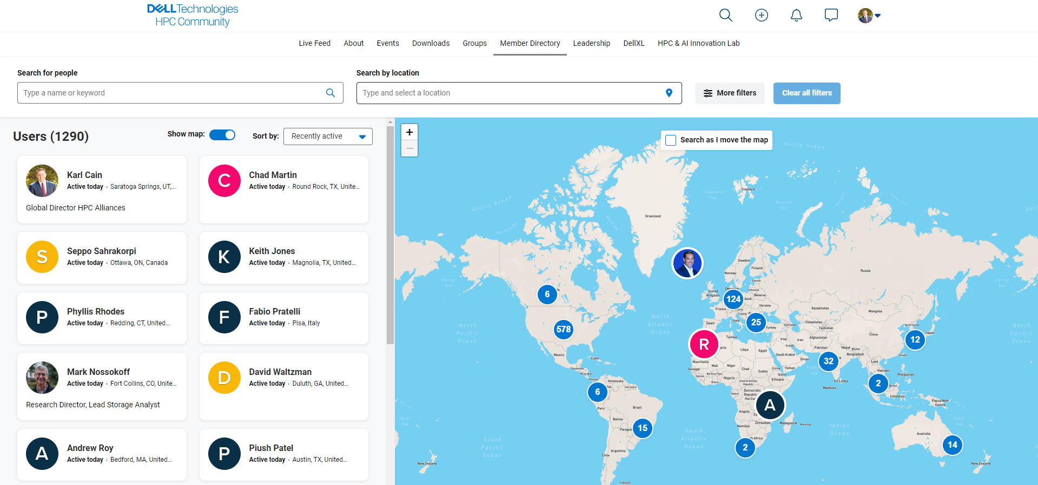
Join the Platform:
Find collaborators, Partners, Customers, and Colleagues!
It also makes registrations easy!
Dellhpc.org

Slide 6
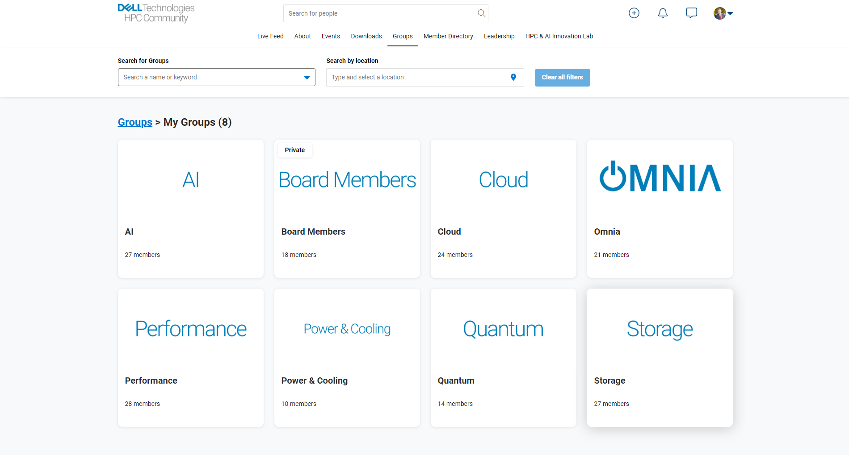
Join the platform, share info and ask questions!
These groups are for sharing information, enabling discussion, etc. towards the goals of advancing HPC!
Professional, constructive, no NDA content
Dellhpc.org

Slide 7
During Online Events, We Encourage You To…
Self-introduce in Zoom Chat to meet new people, and potentially new collaborators, partners, customers, mentors, etc.
Select “Everyone” before you post (default is only Host and Panelists)
Name, title / role in HPC, company / institution
Contact info (LinkedIn, email, etc.) if you want people to connect to you
Where you’re connecting from (and maybe the weather…)
Please be respectful of presenters, attendees, and the purpose of this event
Ask (submit) questions for presenters in Zoom Q&A (not Chat)
You may be promoted to ask your question live (voice, not camera), time permitting
You can ask question of other attendees in Zoom Chat

Slide 8
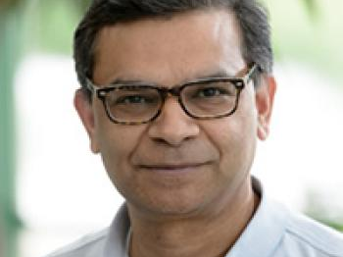
Today: How HPC Enables Modeling Climate Change
Rao Kotamarthi, Senior Scientist, Argonne National Laboratory

Slide 9
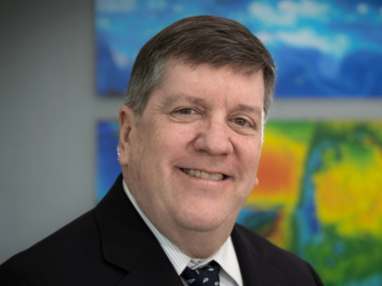
Next Week: No Sessions due to 4th of July Holiday July 12th: Severe Weather Impacts of Climate Change
Michael Wehner, Senior Scientist, LBL

Slide 10
Upcoming Events
Date | Topic | Presenter(s)
June 28 | How HPC Enable Modeling Climate Change | Rao Kotamarthi, Argonne
July 5 | No meeting
July 12 | Severe Weather Impacts of Climate Change | Michael Wehner, LBNL
July 19 | HPC for Generative AI | John Lockman, Ben Fauber, Justin King
July 26 | Dell CTO Perspective: Optical is the Future of HPC | Jeff Kirk, Dell Technologies
August | No weekly events

Slide 11
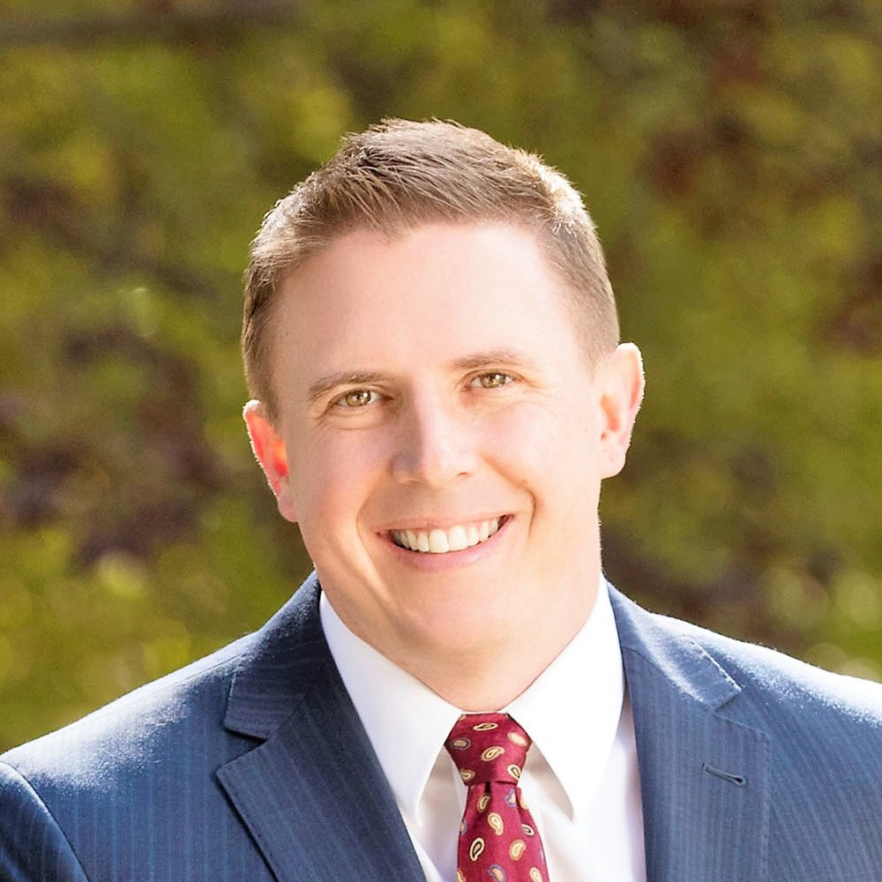
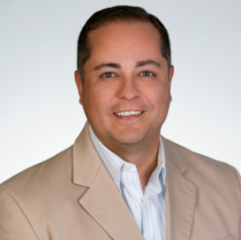
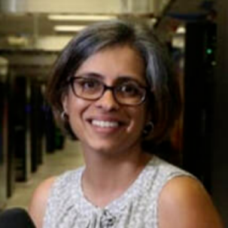
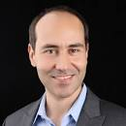
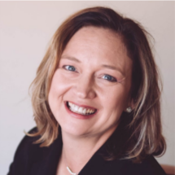
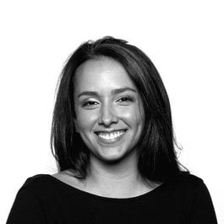
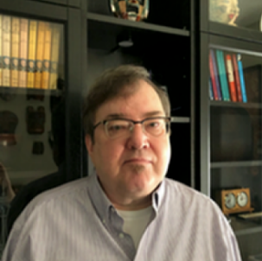
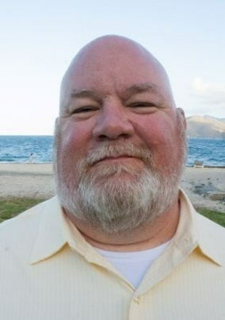
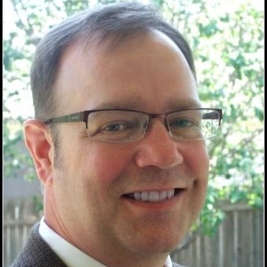
The Dell Technologies HPC Community Team
Karl Cain Co-Director
Armando Acosta Co-Director
Garima Kochhar HPC CTIO
Onur Celebioglu HPC CTIO
Kami Periman HPC PM
Delanie Majors Communications
Mary Garza UX & Web
Jeff Kirk HPC CTIO
Ken Gudenrath Reports, NDAs
David Neville Programming
We’re here to help make this Community strong! Questions or suggestions?
Send email to info@dellhpc.org

Slide 12
Thank you for being part of the Dell Technologies HPC Community!

